Slide 1
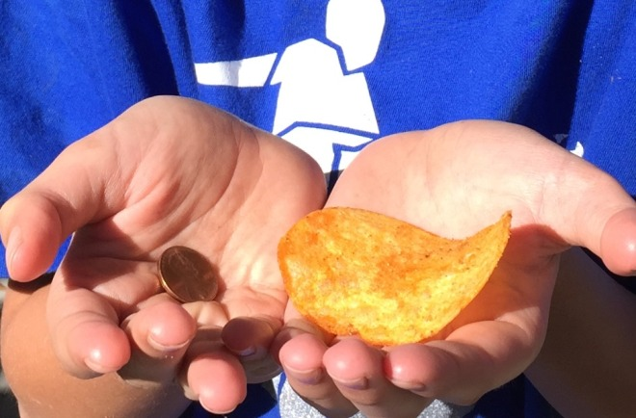
Would You Rather Have a Penny or a Potato Chip?
Notes:
A unit price activity. Play a bit of Would You Rather. Perhaps have students record their option using Plickers.
http://www.wired.com/2015/01/rather-potato-chip-penny/
Potato Chip or a Penny from Wired- During lunch, my son had a great insight. Here’s what he had to say. “This chip is worth a penny. There are probably 200 chips in the whole bag of potato chips and the bag cost like $2.00. That means that each chip is a penny. You are eating a penny.” Have students find the unit price of one potato chip. How do other types of chips compare?

Slide 2
How much does a potato chip cost?
Notes:
Once students have had a chance to answer the Potato chip or penny question, have them try to estimate the price of a single potato chip. What information would they need to calculate the actual price. Would a potato chip or a Dorito cost more? Why do you think this? (potato vice corn, profit margins, different companies might be more efficient, location of factory and labour/transportation costs?)

Slide 3
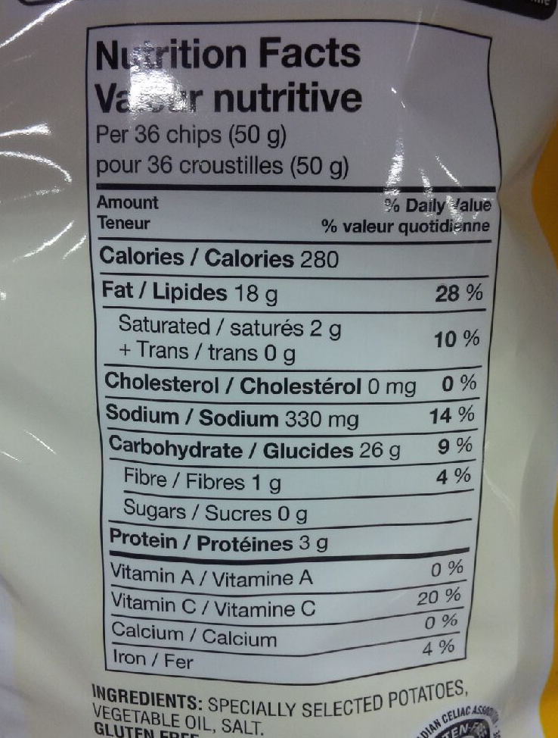
255g bag

Slide 4
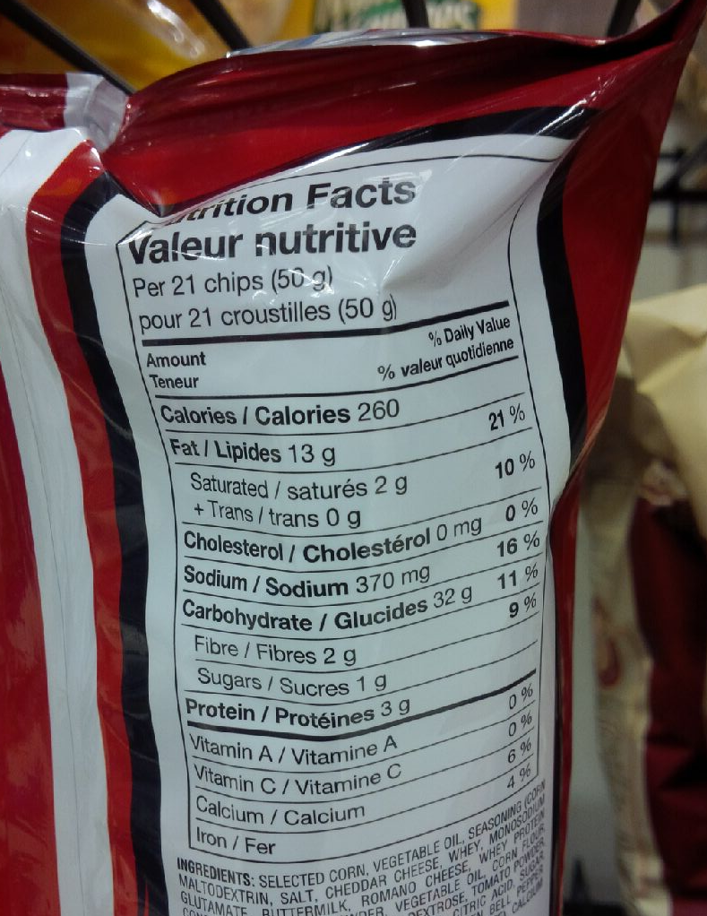
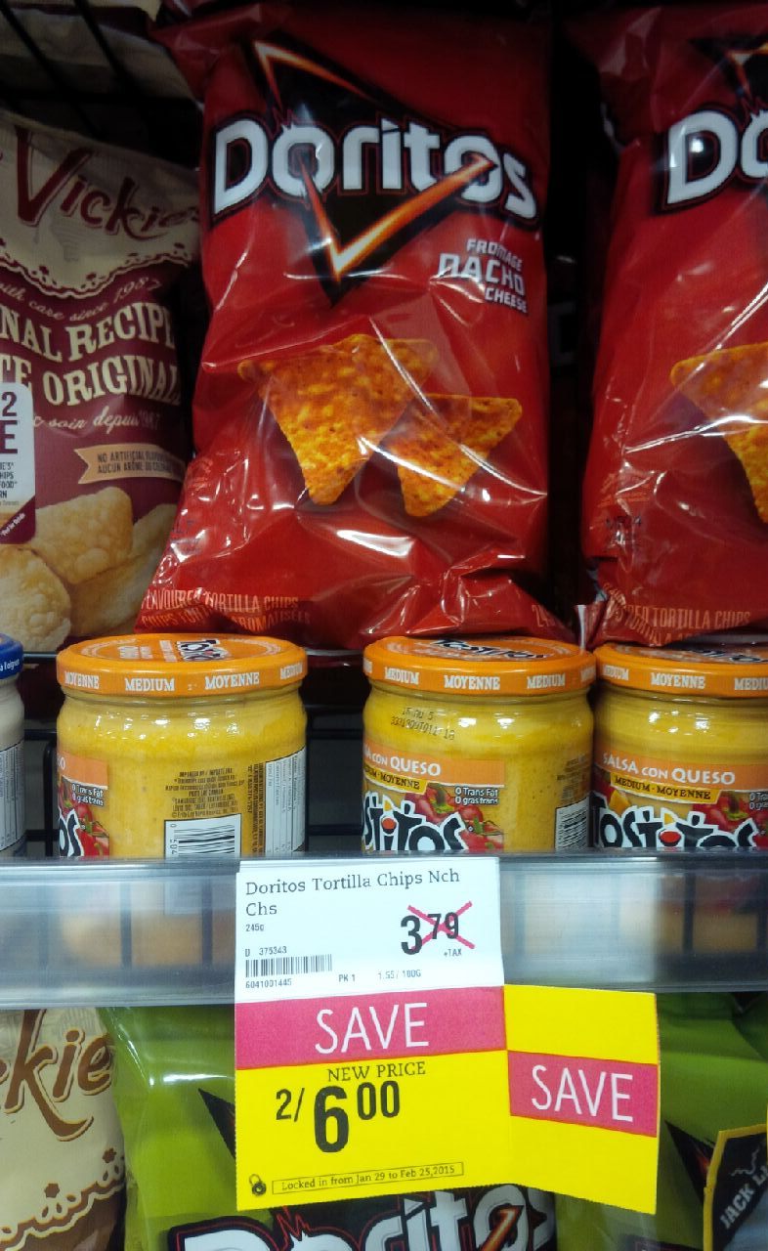
265g bag

Slide 5
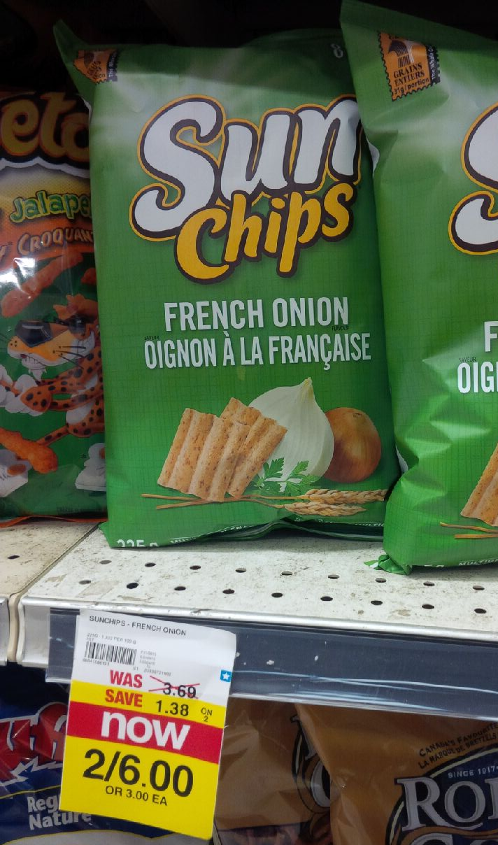
225g bag

Slide 6
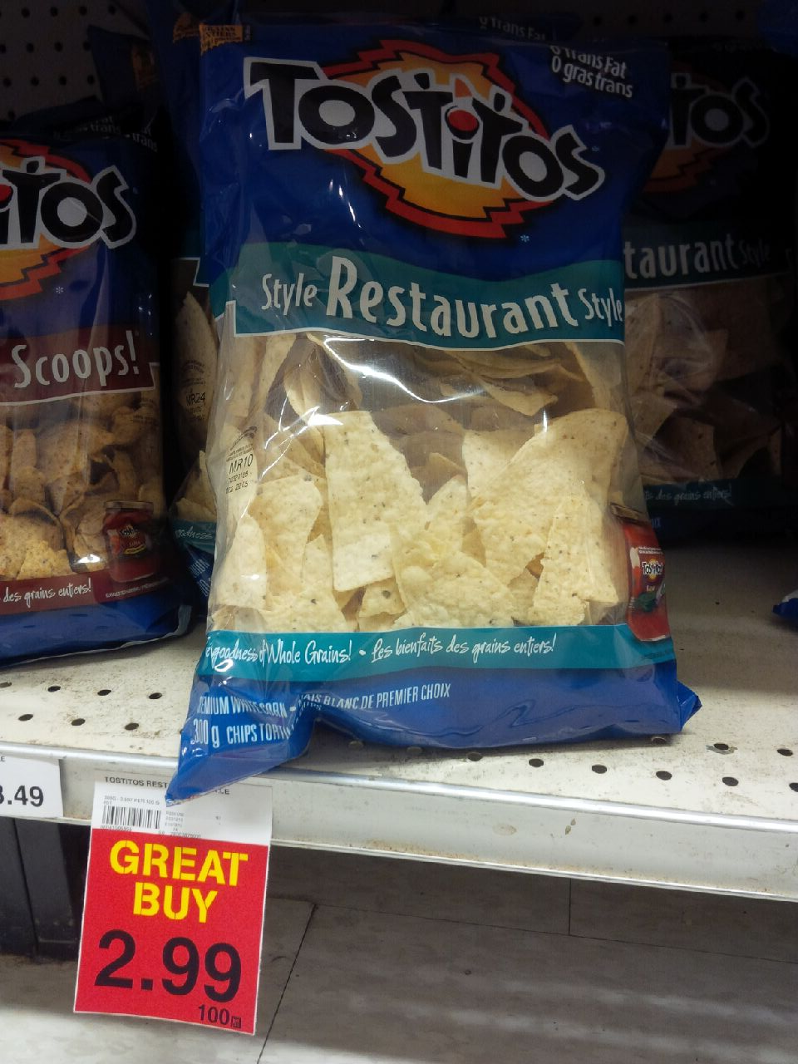
300g bag

Slide 7
More Questions…
But wait! There are still more questions.
Do bigger bags of chips have a lower chip price than those tiny bags from the vending machine?
How much does it cost for the bag itself?
What is the surface area of each of those bags?
How might you calculate volume of a bag like that?
What is the price per calorie?
Notes:
Price per calorie… a classic debate by poor college students.

Slide 8
